Slide 1
Dominos - Predictive Purchase Order System
Domain: Food Service Industry

Slide 2
Problem Statement
Dominos wants to optimize the process of ordering ingredients by predicting future sales and creating a purchase order.
By accurately forecasting sales, Dominos can ensure that it has the right amount of ingredients in stock, minimizing waste and preventing stock outs.
project aims to leverage historical sales data and ingredient information to develop a predictive model and generate an efficient purchase order system for next one week.

Slide 3
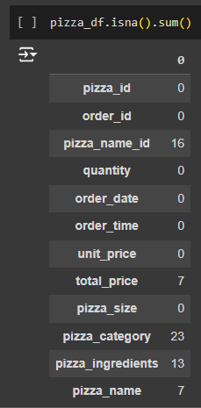
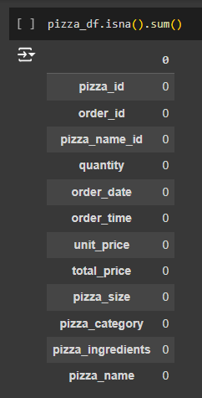

Data Cleaning
Handling missing Data: Delete all null values

Slide 4
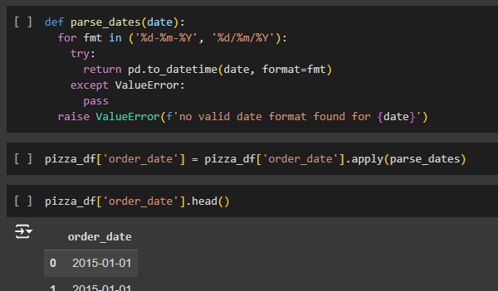
Feature Engineering
Modify the ‘order_date’ column data type from string to the appropriate date time format.

Slide 5
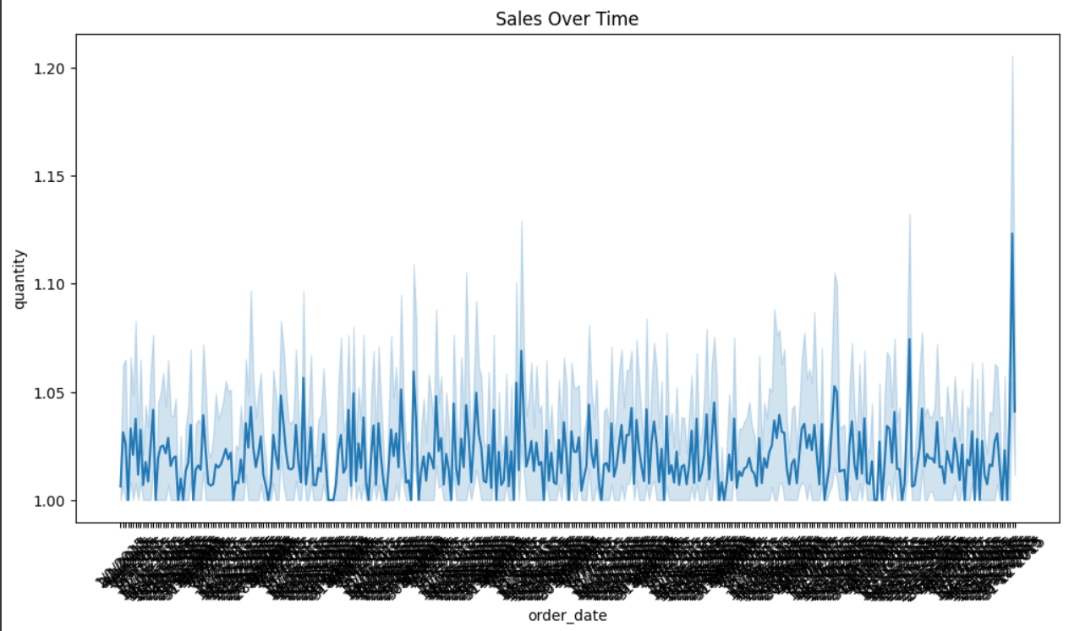
EDA

Slide 6
Determining - p, q and d values
In an ARIMA (p,d,q) model, p, d, and q are parameters that specify the model's components:
p: The order of the autoregressive model, also known as the lag order
d: The degree of differencing, or the number of times the raw observations are differenced
q: The order of the moving-average model, also known as the size of the moving average window

Slide 7
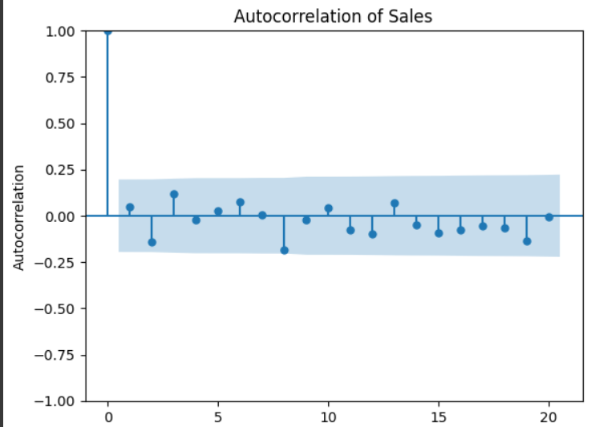
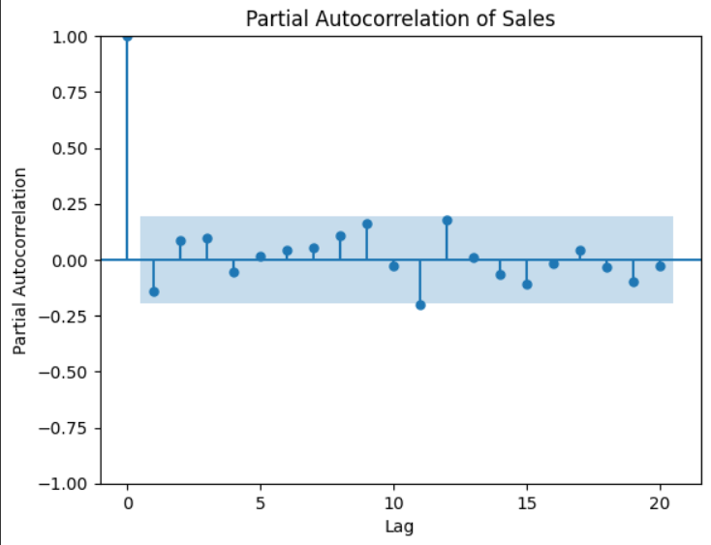
Acf and pacf
Q = 1
P = 1

Slide 8
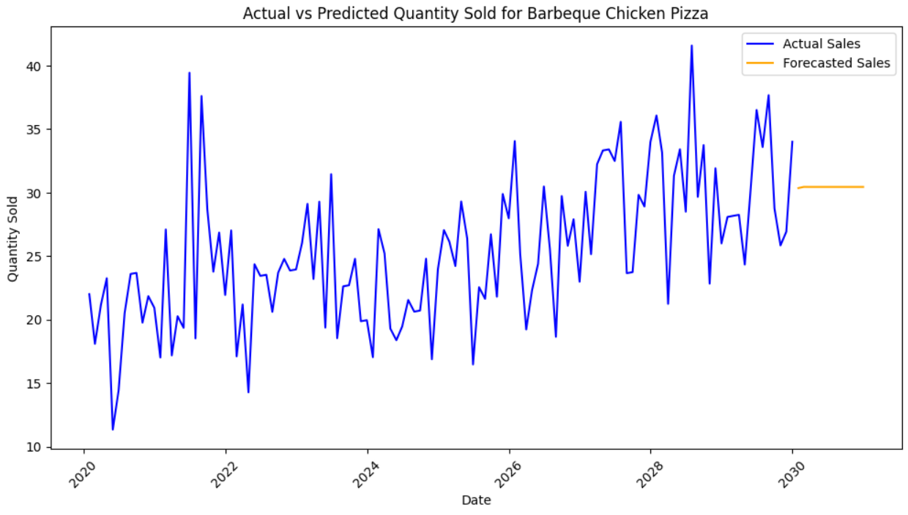
Arima model evaluation

Slide 9
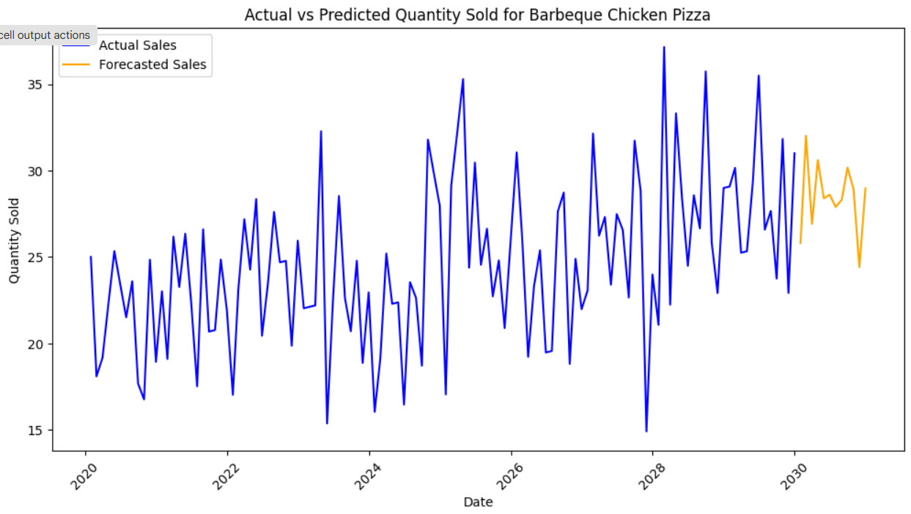
Sarimax model

Slide 10
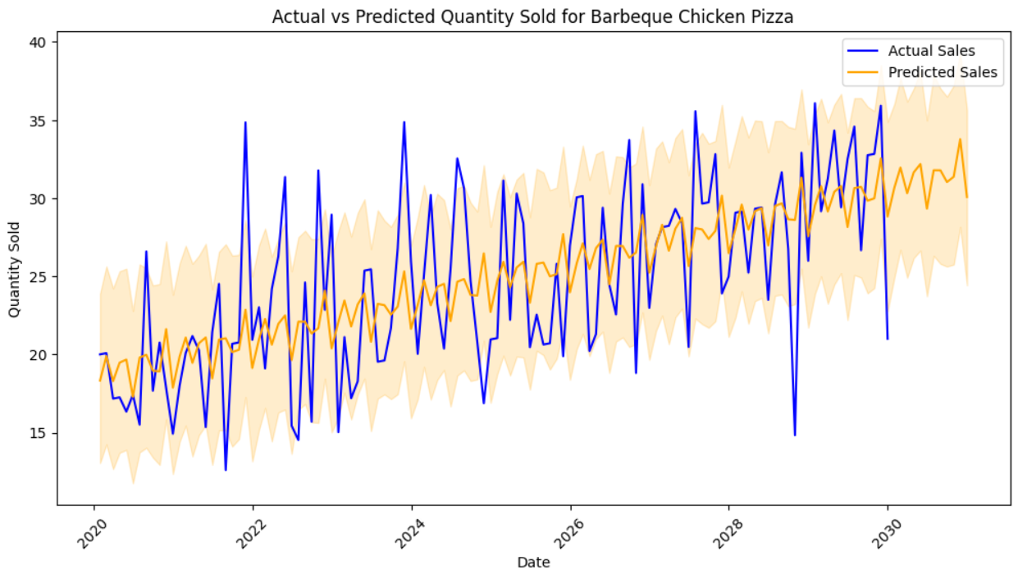
Prophet model

Slide 11
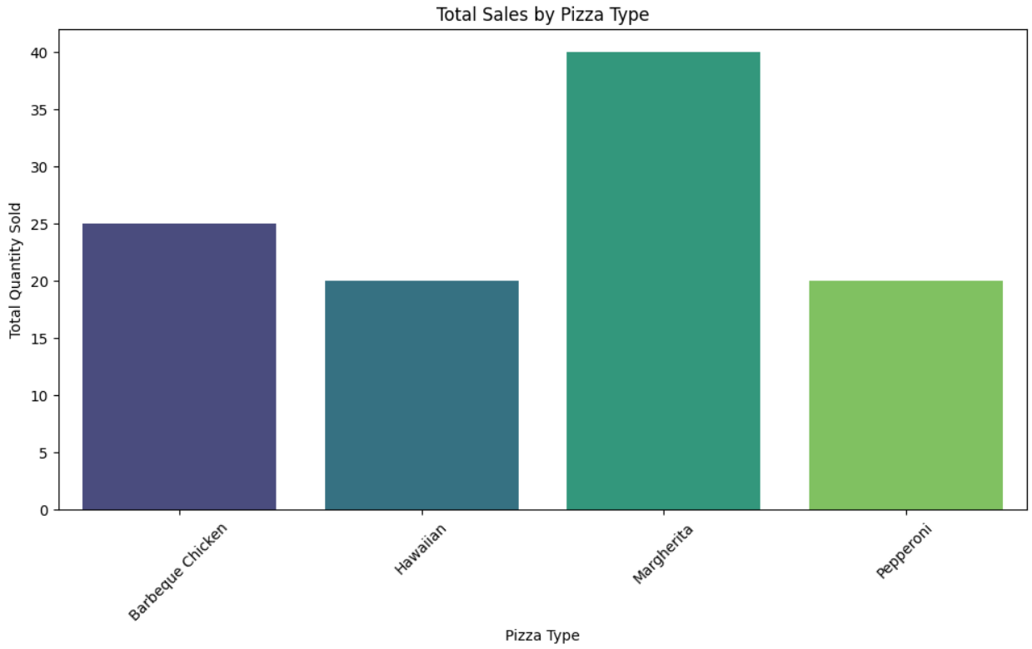
Sales by pizza type

Slide 12
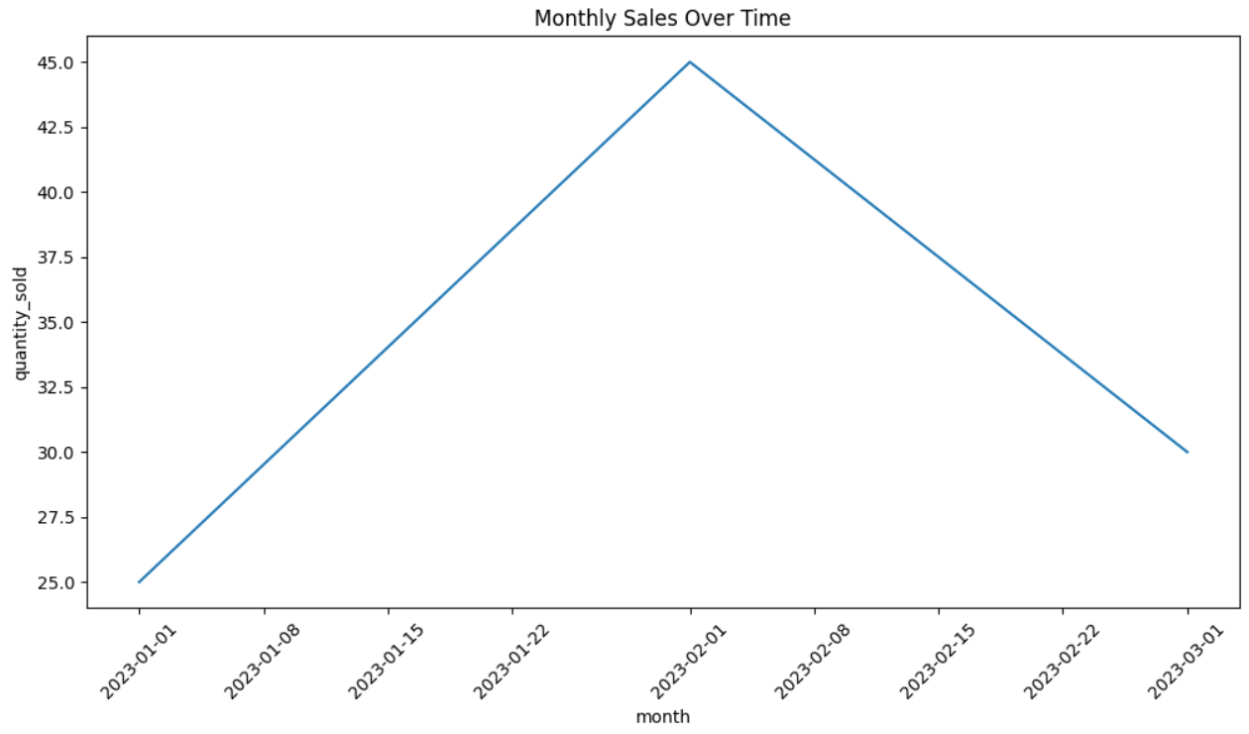
Monthly sale

Slide 13
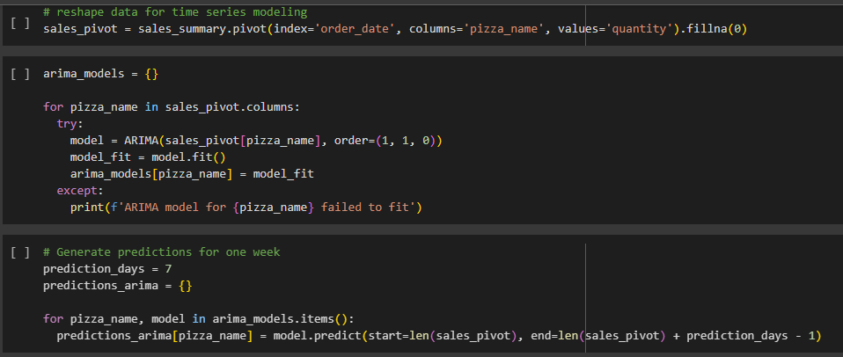
Model TRaining

Slide 14
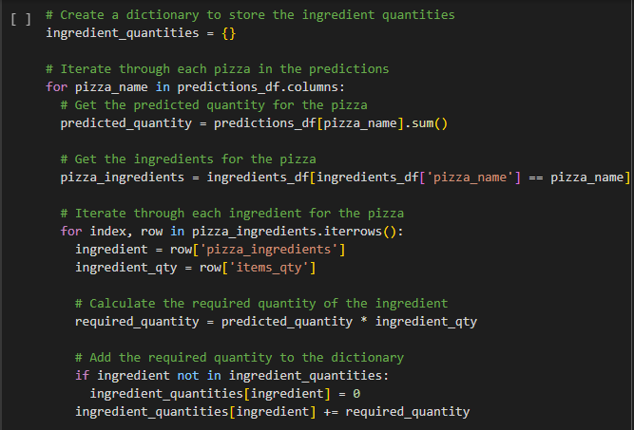
Ingredient Calculation

Slide 15
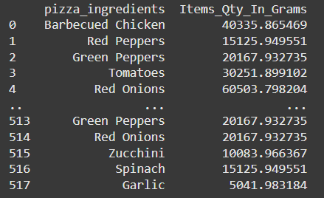
Purchase Order generation

